Slide 1
8279: Keyboard/Display Controller
Intel’s 8279 is a general purpose keyboard display controller that simultaneously drives the display of a system and interfaces a key board with the CPU, leaving it free for its routine task.
The key board display interface scans the key board to identify if any 7 key has been pressed and sends the code of the pressed key to the CPU.
It also transmits the data received from the CPU, to the display device.
Both of these functions are performed by the controller in repetitive fashion without involving the CPU.
The key board display controller chip 8279 provides
(a) set of four scan lines and eight return lines for interfacing key boards
(b) a set of eight output lines for interfacing display.

Slide 2
8279: Keyboard/Display Controller
I/O control and Data buffers
The I/O control section controls the flow of data to / from the 8279.
The data buffers interface the external bus of the system with internal bus of 8279.
The I/O section is enabled only if D bar is low.
The pins A0, RD bar and WR bar select the command, status or data read/ write operations carried out by the CPU with 8279.
Control and Timing Register and Timing Control
These registers store the key board and display modes and other operating conditions programmed by CPU.
The registers are written with A0 = 1 and WR bar =0.

Slide 3
8279: Keyboard/Display Controller
Scan Counter
The scan counter has two modes to scan the key matrix and refresh the display.
In the second encoded mode, the counter provides a binary count that is to be externally decoded to provide the scan lines for key board and display (four externally decoded scan lines may drive up to 16 displays).
n the decoded scan mode, the counter internally decodes the least significant 2 bits and provides a decoded 1 out of 4 scan on SL0 – SL3 (four internally decoded scan lines may drive up to 4 displays).
The key board and display both are in the same mode at a time.
Return Buffers and Keyboard Debounce and Control:
This section scans for a key closure row-wise. I
f it is detected, the keyboard debounce unit debounces the key entry (i.e. wait for 10 ms).
After the debounce period, if the key continues to be detected.
The code of the key is directly transferred to the sensor RAM along with SHIFT and CONTROL key status.

Slide 4
8279: Keyboard/Display Controller
FIFO/Sensor RAM and Status Logic :
In keyboard or strobed input mode, this block acts as 8-byte first in first out (FIFO) RAM.
Each key code of the pressed key is entered in the order of the entry, and in the mean time, read by the CPU, till the RAM becomes empty.
In scanned sensor matrix mode, this unit acts as sensor RAM.
Display Address Registers and Display RAM :
The display address registers hold the address of the word currently being written or read by the CPU to or from the display RAM.

Slide 5
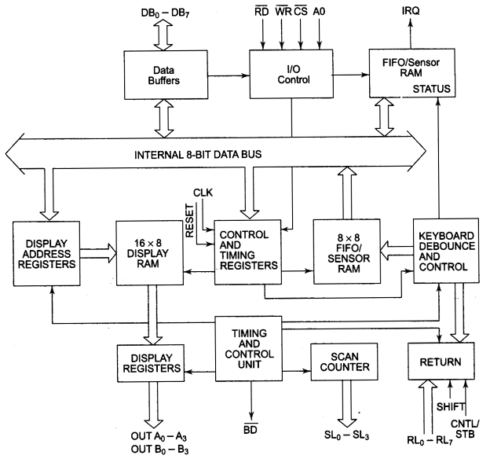
8279: Internal Architecture

Slide 6
8279: Pin Description
DB0 – DB7
These are bidirectional data bus lines. The data and command words to and from the CPU are transferred on these lines.
A0
A high on the A0 line indicates the transfer of command or status information. A low on this line indicates the transfer of data.
IRQ
This interrupt outline goes high when there is data in the FIFO sensor RAM.
SL0 – SL3
these lines are used to scan the key board matrix and display digits.
RL0 – RL7 – Return Lines
These lines are the input lines which are connected to one terminal of keys, while the other terminal of keys are connected to the decoded scan lines.
These are normally high, but pulled low when a key is pressed.

Slide 7
8279: Pin Description
SHIFT :
The status of the shift input line is stored along each key code in FIFO in the scanned key board mode. Till it is pulled low with a key closure it is pulled up internally to keep it high.
CNTL/STB – CONTROL/STROBED I/P Mode
In the key board mode, this line is used as a control input and strobed in FIFO on a key closure.
BD bar – Blank Display
This output pin is used to blank the display during digit switching or by a blanking command.
OUTA0 – OUTA3 and OUTB0 – OUTB3
These are the output ports for two 16 X 4 (or one 16 X 8) internal display refresh registers.
The data from these lines is synchronized with the scan lines to scan the display and key board.
The two 4 – bit ports may also be used as one 8 – bit port.

Slide 8
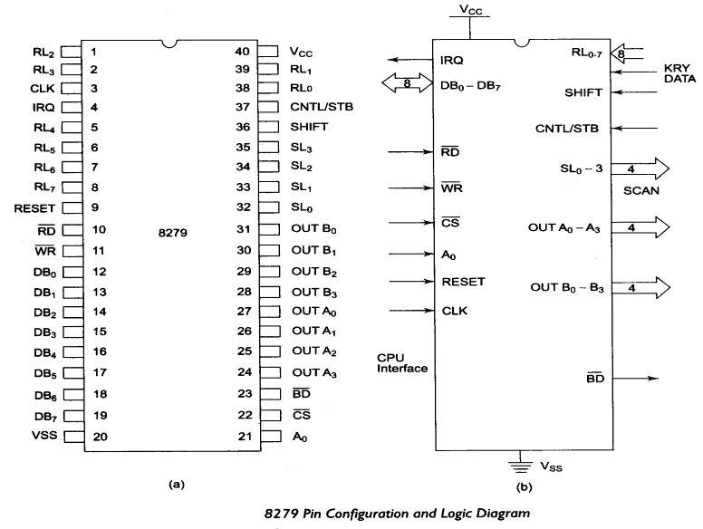
8279: Pin Configurations and Logic Diagram

Slide 9
8279: Modes of Operation
Modes of Operation:
Input (keyboard) modes
Output (display) modes.
Scanned Key board Mode:
This mode allows a key matrix to be interfaced using either encoded or decoded scans.
Scanned Sensor Matrix:
In this mode, a sensor array can be interfaced with 8279 using either encoded or decoded scans.
Strobed input
In this mode, if the control line goes low, the data on return lines, is stored in the FIFO byte by byte.

Slide 10
8279: Modes of Operation
Output (Display) modes:
8279 provides two output modes for selecting the display options. These are discussed briefly:
Display scan:
In this mode, 8279 provides 8 or 16 character multiplexed displays those can be organized as dual 4 bit or single 8 bit display units.
Display Entry
right entry or left entry mode
8279 allows options for data entry on the displays.
The display data is entered for display either from the right side or from the left side.

Slide 11
8279: Command Words
All the command words or status words are written or read with A0 =1 and CS bar =0 to or from 8279.
Keyboard Display Mode Set
The format of the command word to select different modes of operation of 8279 is given below with its bit definitions.

Slide 12
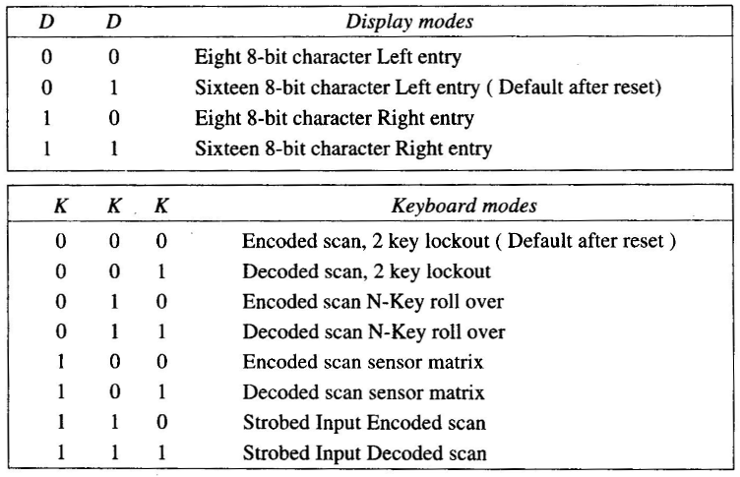
8279: Command Words
Keyboard Display Mode Set

Slide 13



8279: Command Words
Programmable Clock:
Read FIFO Sensor RAM:
Read Display RAM:
Write Display RAM:

Slide 14



8279: Command Words
Display Write Inhibit/Blanking:
Clear Display RAM:
End Interrupt/Error Mode Set:

Slide 15
8279: Command Words
Read Display RAM This command enables a programmer to read the display RAM data.
Display Write inhibit/Blanking The IW (Inhibit Write flag) bits are used to mask the individual nibble as shown in the above command.
Clear Display RAM The CD2,CD1,CD0 is a selectable blanking code to clear all the rows of the display RAM as given below.
CD2 must be 1 for enabling the clear display command.
For the sensor matrix mode, this command lowers the IRQ line and enables further writing into the RAM.

Slide 16
8279: Command Words
Programmable Clock The clock for operation of 8279 is obtained by dividing the external clock input signal by a programmable constant called prescaler.
PPPPP is a 5 bit binary constant. The input frequency is divided by a decimal constant ranging from 2 to 31, decided by the bits of an internal prescaler, PPPPP.

Slide 17
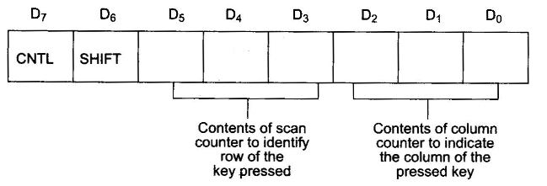
8279: Key Code and Status Data Format
Key – code Data Formats
After a valid key closure, the key code is entered as a byte code into the FIFO RAM, in the following format, in scanned keyboard mode.

Slide 18

8279: Key Code and Status Data Format
In the sensor matrix mode, the data from the return lines is directly entered into an appropriate row of sensor RAM, that identifies the row of the sensor that changed its status.
The SHIFT and CNTL keys are ignored in this mode. RL bits represents the return lines. Rn represents the sensor RAM row number that is equal to the row number of the sensor array in which the status change was detected.

Slide 19
8279: Key Code and Status Data Format
FIFO Status Word:
The FIFO status word is used in keyboard and strobed input mode to indicate the error.
Overrun error occurs, when an already full FIFO is attempted an entry.
Under run error occurs when an empty FIFO read is attempted.
FIFO status word also has a bit to show the unavailability of FIFO RAM because of the ongoing clearing operation.
The status word contains FIFO status, error and display unavailable signals.
This is read, when A0=1, RD Bar=0 and CS Bar =0. Data is read when A0, CS Bar, RD bar are low.

Slide 20
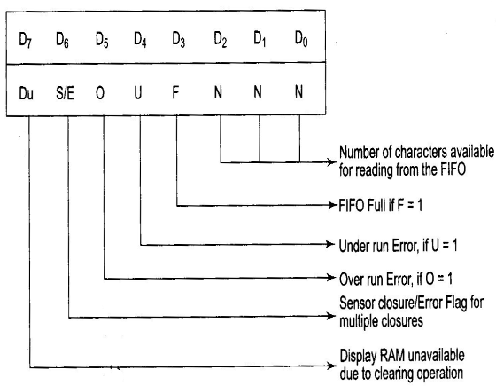
8279: Key Code and Status Data Format
FIFO Status Word:

Slide 21
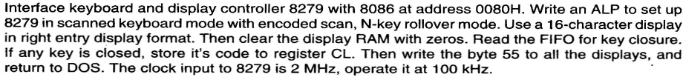
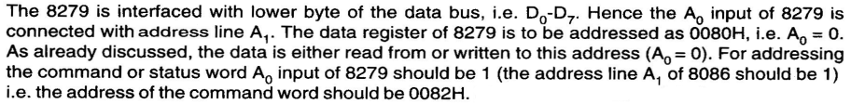
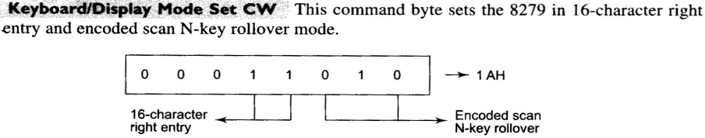
8279: Interfacing with 8086
Solution:

Slide 22
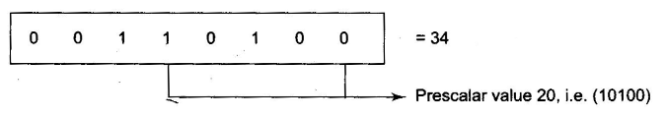
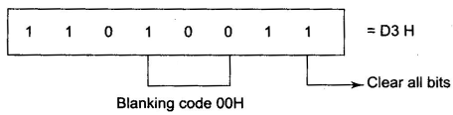
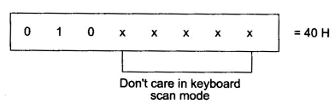
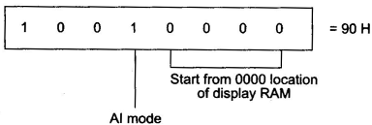
8279: Interfacing with 8086
Program Clock Selection:
Clear Display RAM:
Read FIFO:
Write Display RAM:

Slide 23
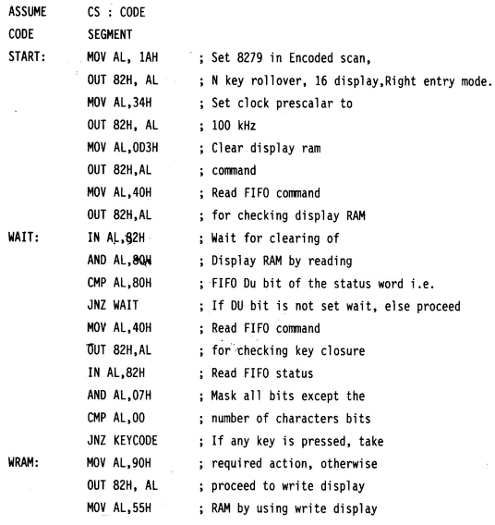
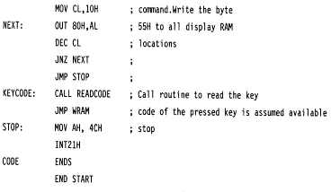
8279: Interfacing with 8086

Slide 24
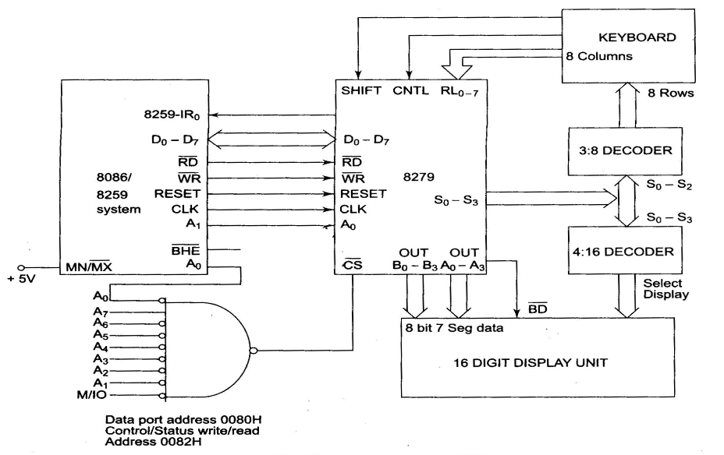
8279: Interfacing with 8086

Slide 25
8251:Programmable Communication Interface (USART)
Intel’s 8251A is a universal synchronous a synchronous receiver and transmitter compatible with Intel’s processors.
This may be programmed to operate in any of the serial communication modes built into it.
The data transmission between two points involves unidirectional or bidirectional transmission of meaningful digital data through a medium.
There are basically three modes of data transmission:
Simplex
Duplex
Half Duplex

Slide 26
8251: Signal Description
D0 – D7
This is an 8 bit data bus used to read or write status, command word or data from or to the 8251 A.
C/D bar- Control Word/ Data
This input pin, together with RD bar and WR bar inputs, informs the 8251 A that the word on the data bus is either a data or control word/status information.
RD bar
This active low input to 8251 A is used to inform it that the CPU is reading either data or status information from its internal registers.
WR bar
This active low input to 8251 A is used to inform it that the CPU is writing data or control word to 8251 A.
CS bar
This is an active low chip select input of 8251 A. if it is high, no read or write operation can be carried out on 8251.
CLK
This input is used to generate internal device timings and is normally connected to clock generator output.

Slide 27
8251: Signal Description
RESET
A high on this input forces the 8251 A into an idle state.
TXC bar Transmitter Clock Input
This transmitter clock input controls the rate at which the character is to be transmitted.
TXD Transmitted Data Output
This output pin carries serial stream of the transmitted data bits along with other information like start bit, stop bits and parity bit, etc.
RXC bar receiver Clock Input
This receiver clock input pin controls the rate at which the character is to be received.
RXD- Receive Data Input
This input pin of 8251 A receives a composite stream of the data to be received by 8251 A.

Slide 28
8251: Signal Description
RXRDY – Receiver Ready Output
This output indicates that the 8251 A contains a character to be read by the CPU. The RXRDY signal may be used either to interrupt the CPU or may be polled by the CPU.
TXRDY – Transmitter Ready
This output indicates to the CPU that the internal circuit of the transmitter is ready to accept a new character for transmission from the CPU.
DSR bar – Data Set Ready
The input may be use d as a general purpose one bit inverting input port. Its status can be checked by the CPU using a status operation.
DTR Bar – Data Terminal Ready
This output may be used as a general purpose one bit inverting output port.
RTS Bar – Request to Send Data
This output may be used as a general purpose one bit inverting output port that can be programmed low to indicate the modem that the receiver is ready to receive a data byte from the modem.
This signal is used to communicate with a modem.

Slide 29
8251: Signal Description
CTS Bar – Clear to Send
If the clear to send the input line is low, the 8251 A is enabled to transmit the serial data, provided the enable bit in the command byte is set to ‘1’.
TXE – Transmitter Empty
If the 8251 A, while transmitting, has no characters to transmit, the TXE output goes high and it automatically goes low when a character is received from the CPU, for further transmission.
SYNDET/BD – Synch Detect/Break Detect
This pin is used in the synchronous mode for detecting SYNC characters (SYNDET) and may be used as either input or output.

Slide 30
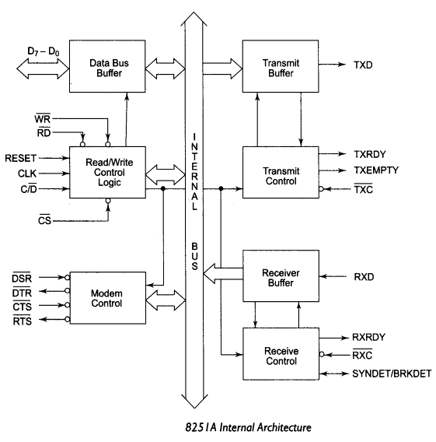
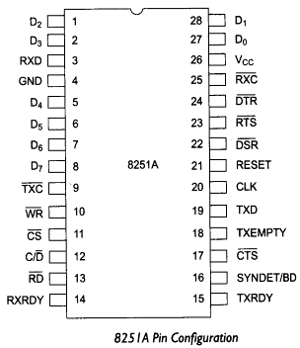
8251: Internal Architecture and Pin Configuration

Slide 31
8251: Operating Modes
The 8251 can be programmed to operate in its various modes using its mode control words.
The control words of 8251 A are divided into two functional types:
Mode Instruction control word
Command instruction control word.
Asynchronous Mode
Mode Instruction control word
This defines the general operational characteristics of 8251 A after internal (reset command) or external (reset input pin) reset, this must be written to configure the 8251 A as per the required operation.
To change the mode of operation from synchronous to asynchronous or vice - versa, the 8251 A has to be reset using master chip reset.

Slide 32
8251: Operating Modes
Asynchronous Mode (Transmission)
When a data character is sent to 8251 A by the CPU, it adds start bits prior to the serial data bits, followed by optional parity bit and stop bits using the asynchronous mode instruction control format.
This sequence is then transmitted using TXD output pin on the falling edge of TXC bar.
A synchronous Mode (Receive)
A falling edge on RXD input line marks a start bit.
At baud rates of 16 x and 64x, this start bit is again checked at the center of start bit pulse and if detected low, it is a valid start bit which starts counting.

Slide 33
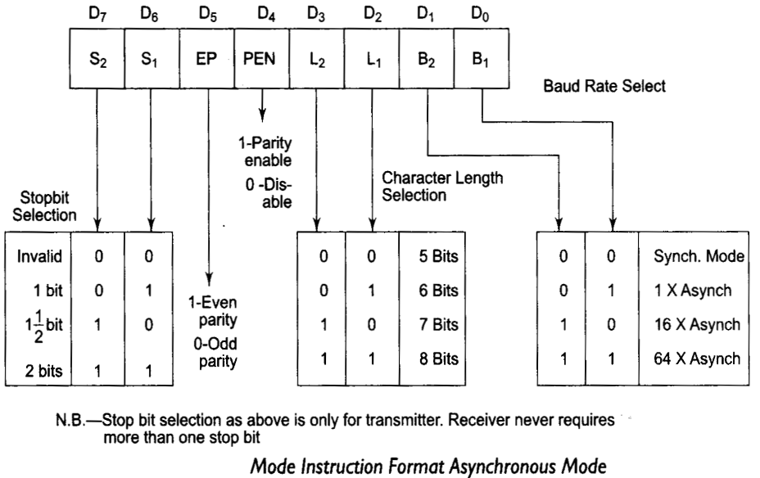
8251: Operating Modes

Slide 34
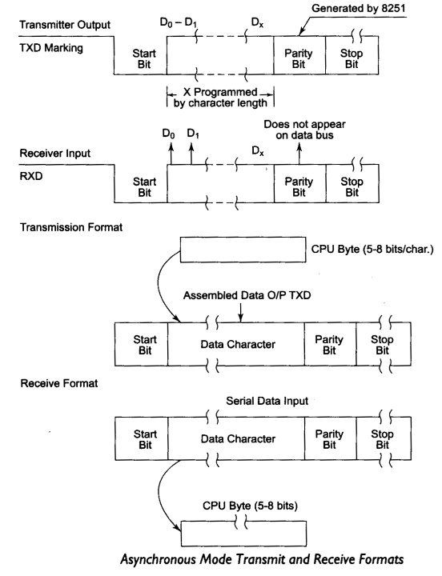
8251: Operating Modes:

Slide 35
8251: Operating Modes
Synchronous Mode
Synchronous Mode (Transmission)
The TXD output is high until the CPU sends a character to 8251 A which is usually is a SYNC character.
When CTS bar line goes low, the first character is serially transmitted out.
All the characters are shifted out on the falling edges of TXC bar.
Data is shifted out at the same rate as TXc bar, over TXD output line.
If the CPU buffer becomes empty, the SYNC character or characters are inserted in the data stream over TXD output.
Synchronous Mode (Receiver)
In this mode, the character synchronization can be achieved internally or externally.
If this mode is programmed, then ‘ENTER HUNT’ command should be included in the first command instruction word written into the 8251 A.
The data on RXD pin is sampled on rising edge of the RXC bar.
The content of the receiver buffer is compared with the first SYNC character at every edge until it matches.

Slide 36
Command Instruction Definition
The command instruction controls the actual operations of the selected format like enable transmit/receive, error reset and modem control.
Once the mode instruction has been written 8251 A and the SYNC characters are inserted internally by 8251 A, all further control words written with C/D =1 will load a command instruction.
A reset operation returns 8251 A back to mode instruction format.

Slide 37
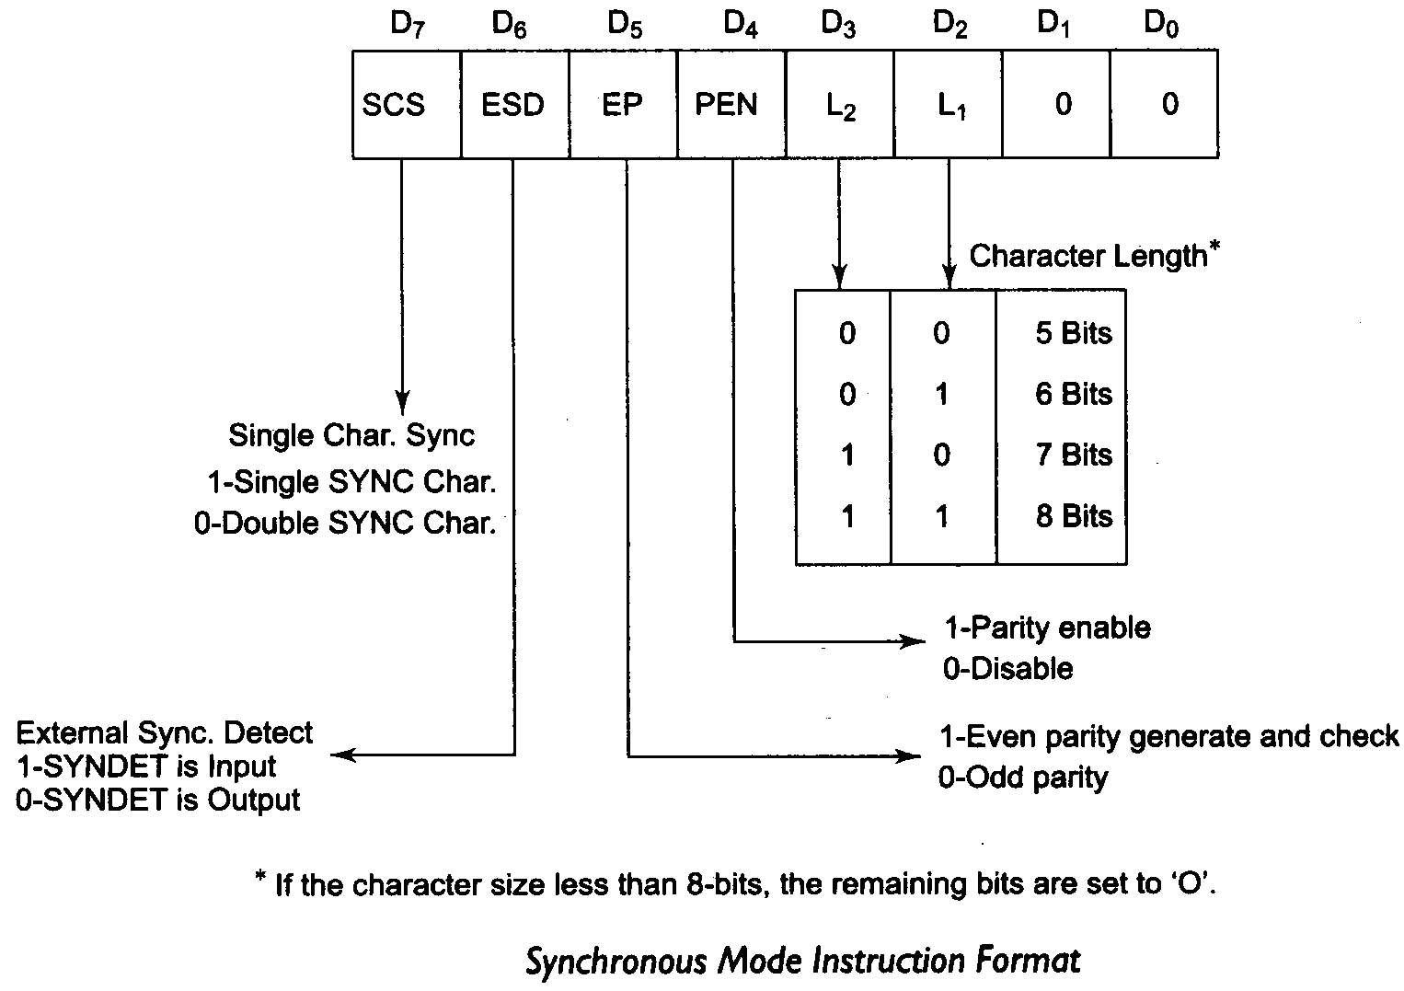
8251: Operating Modes

Slide 38
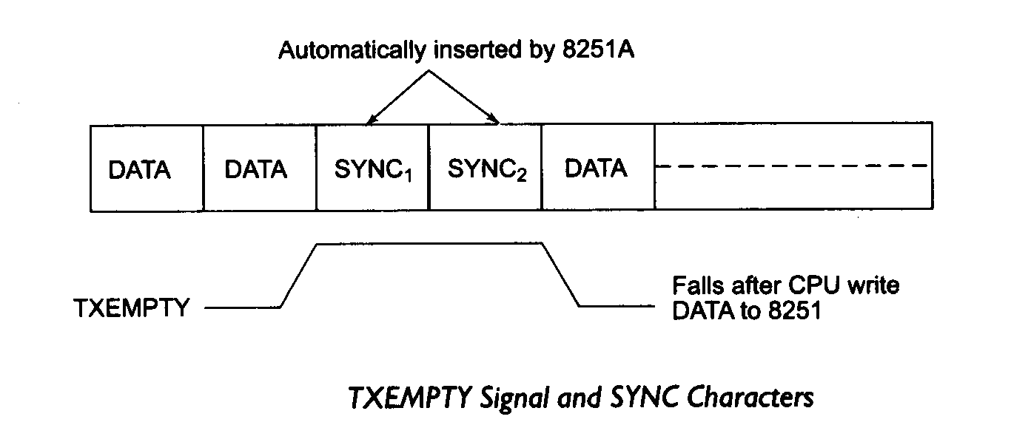
8251: Operating Modes
Status Read Definition
This definition is used by the CPU to read the status of the active 8251 A to confirm if any error condition or other conditions like the requirement of processor service has been detected, during the operation.
A read command is issued by processor with C/D bar =1 to accomplish this function.

Slide 39
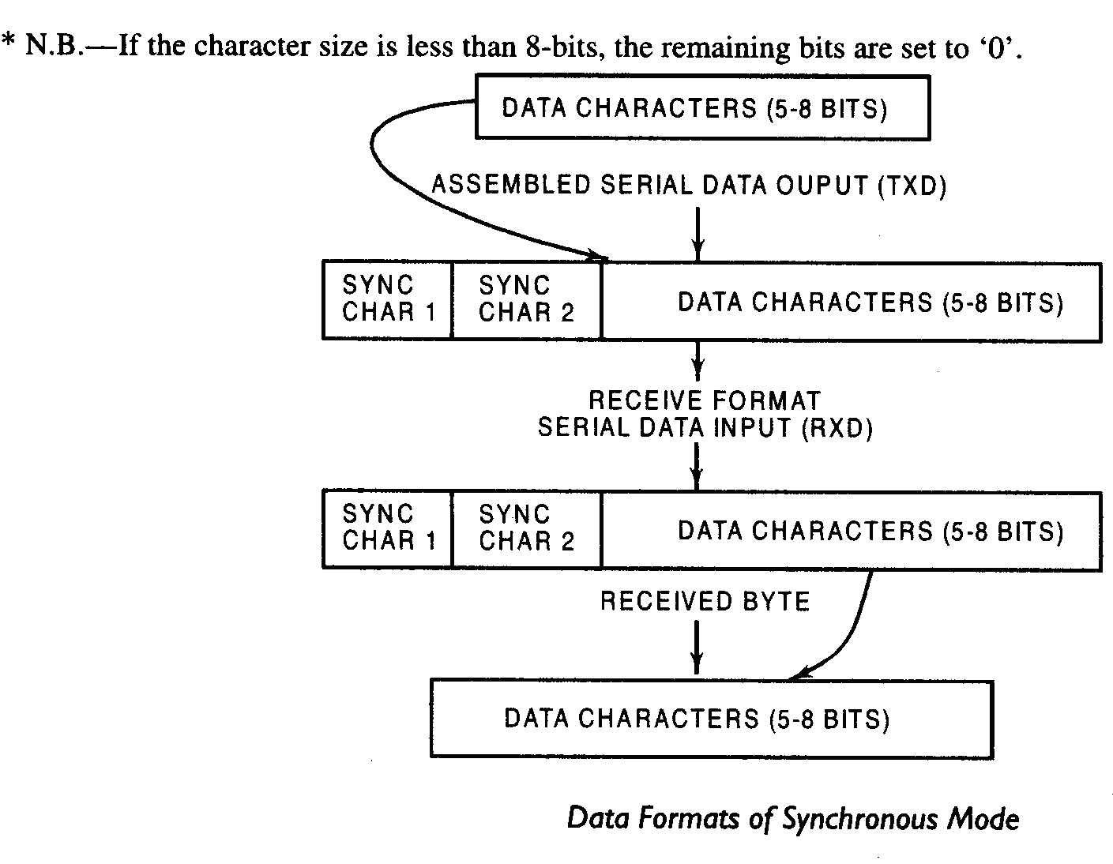
8251: Operating Modes

Slide 40
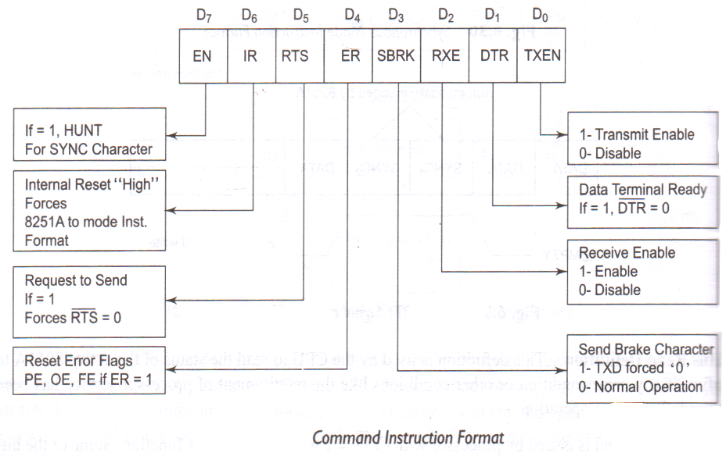
8251: Operating Modes

Slide 41
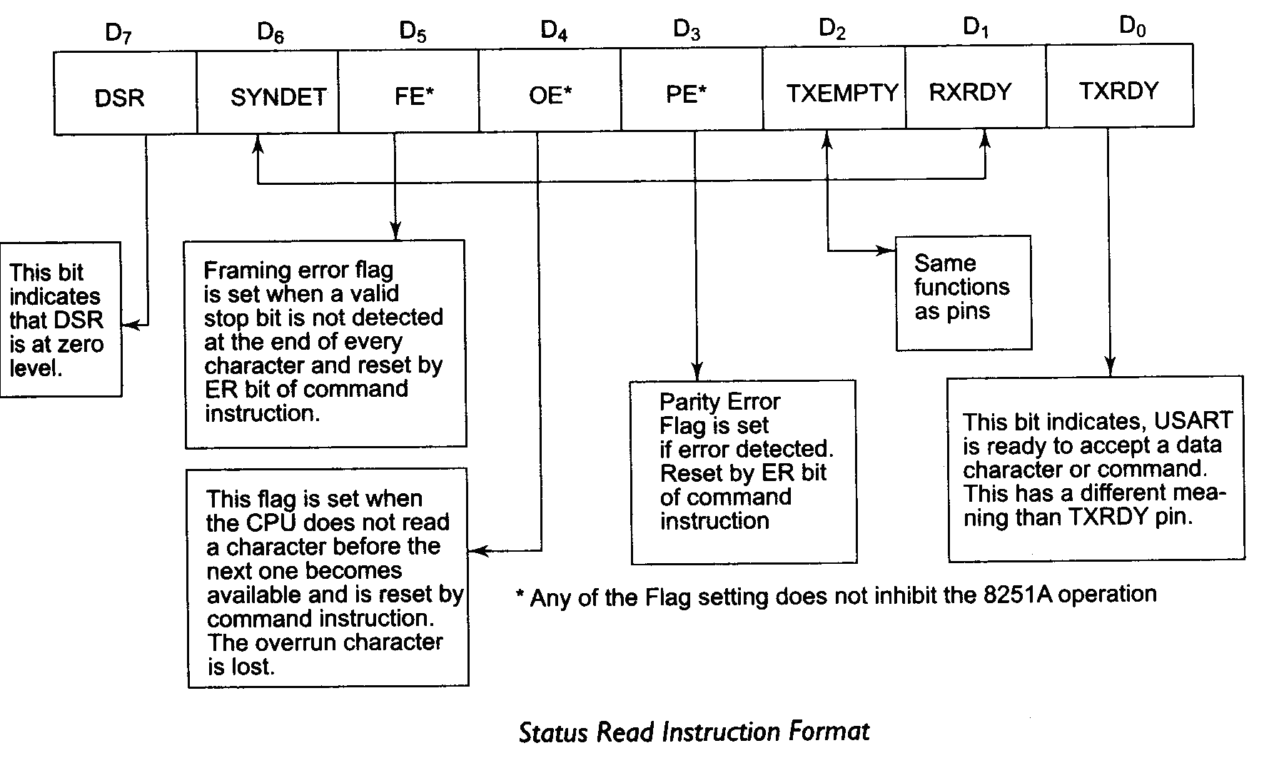
8251: Operating Modes

Slide 42
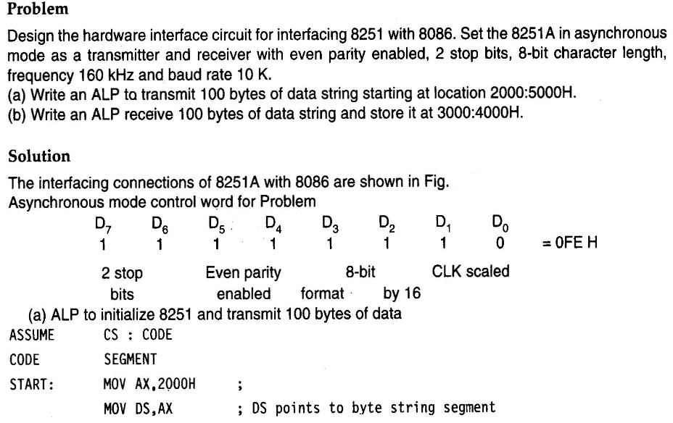
8251: Interfacing with 8086

Slide 43
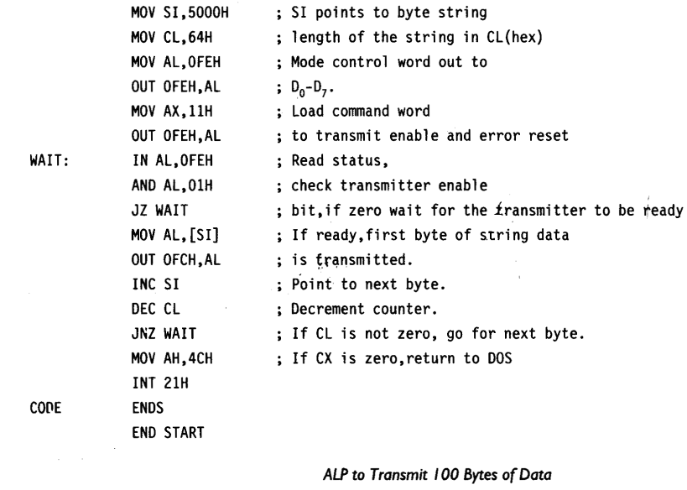
8251: Interfacing with 8086

Slide 44
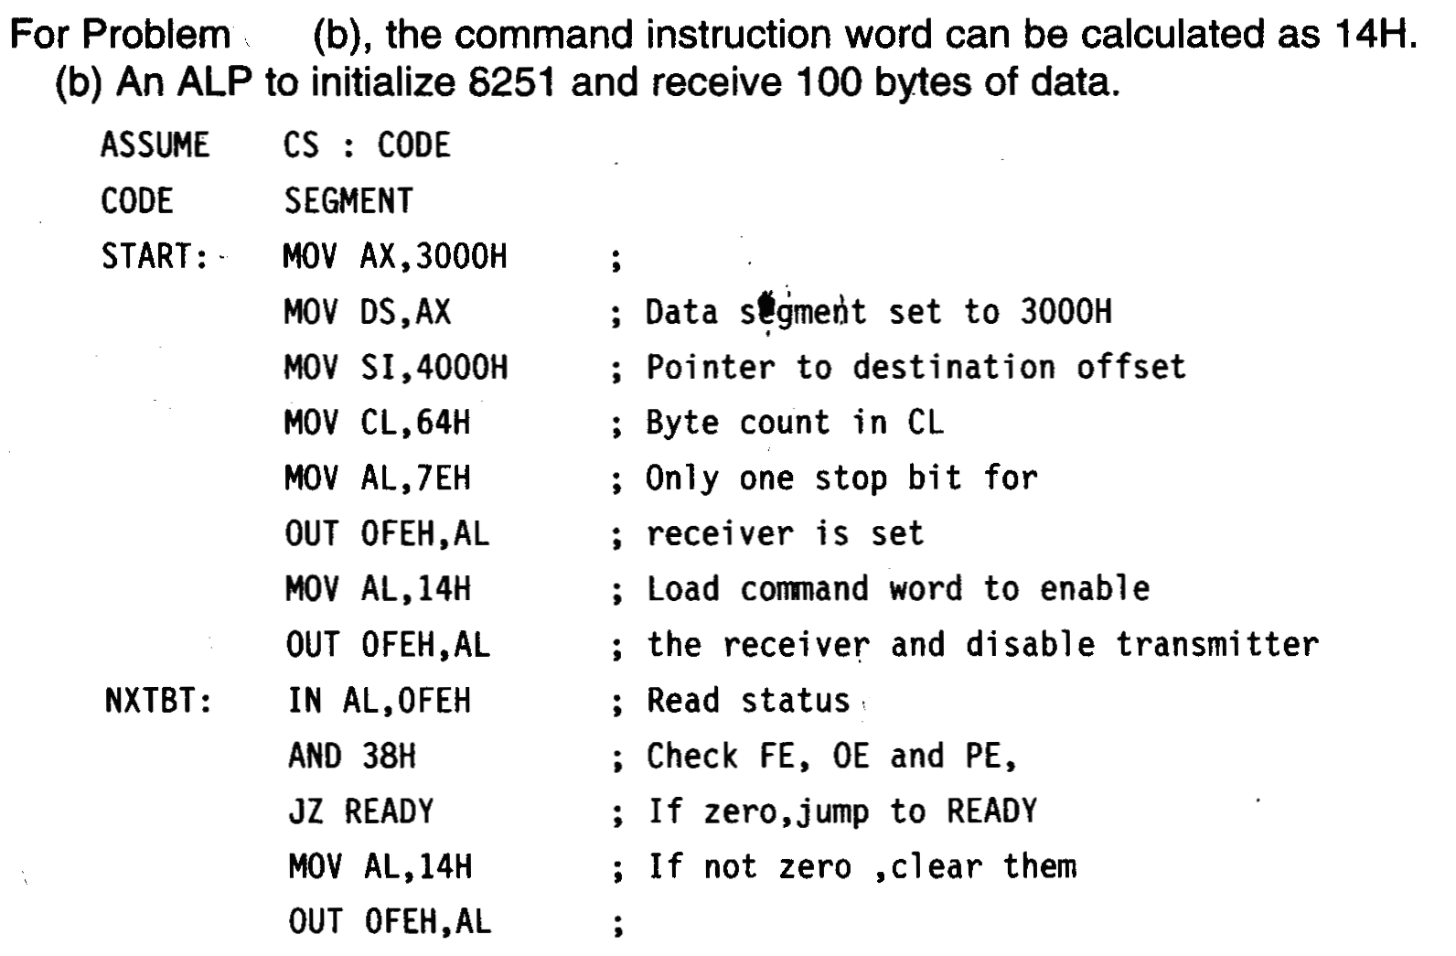
8251: Interfacing with 8086

Slide 45
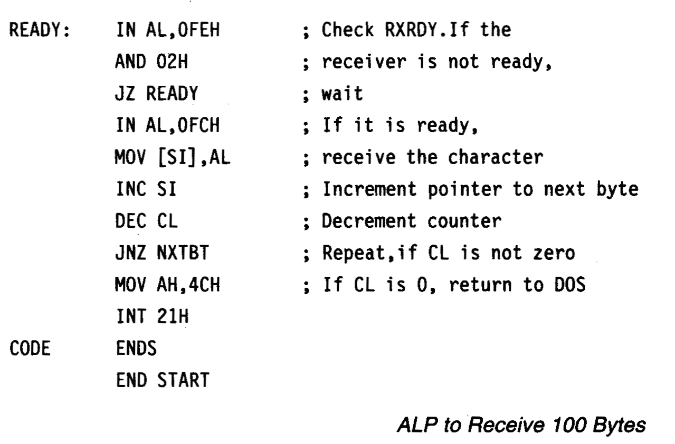
8251: Interfacing with 8086

Slide 46
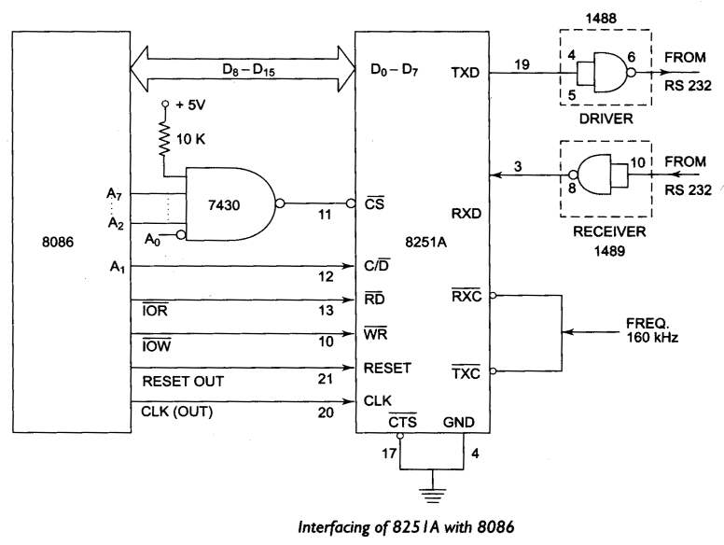
8251: Interfacing with 8086

